Slide 1
Smart Shrimp Farming
IN 1900 (ICT Project)
Final Presentation
Group No: 32

Slide 2

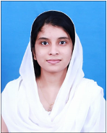
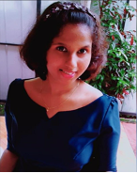

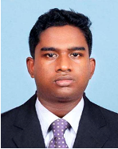
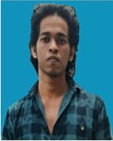
204192X Sara
A.N. Z (Group Leader)
204130H
Megasuriya M.M.A.M.J
204006J
Appuhamy H.D.S.A.N
204155M perera J.K.A.T
204171H Rajapaksha S.S.D

Slide 3
Outline
1.Problem in Brief
2.Aim and objectives
3.Input -output diagram
4.3D diagram
5. Animation
6.Full Circuit
7.Resources Required
8.Cost Estimation
9.Individual Contributions

Slide 4
Problems in Brief
Although shrimp farming gives a huge amount of progress in the economy, the shrimp farmers face more challenges to achieve their expected goals.
▪ Manual monitoring and lack of maintaining proper record
▪ Necessity for more man power
▪ Hard to maintain the growth of shrimps
▪ Lack of knowledge in maintaining the quality of water

Slide 5
Aim & Objectives
Aim
Design and develop the system to assist our local shrimp farmers in easing their work and saving their time.
Objectives
●To help the farmer to control and monitor the shrimp ponds from a distance .
●To feed the shrimps automatically with a proper record of time and mass.
●To monitor the consumption of food easily.
●Monitoring the cultivation using the pH, Temperature, Mass of food and Date and Time schedule of feeding shrimps.
●To operate motors and lamps automatically with a phone.
●To monitor the quality and control the level of water

Slide 6
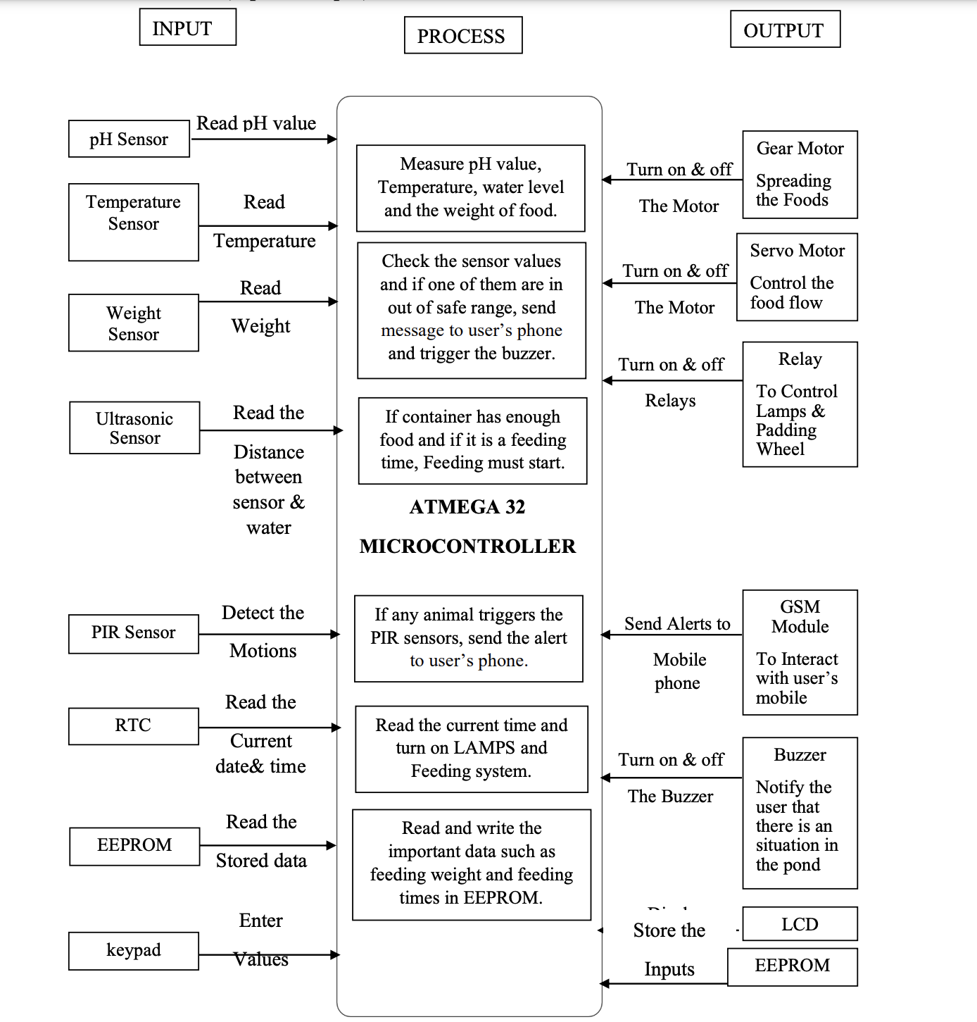
Input Output Diagram

Slide 7
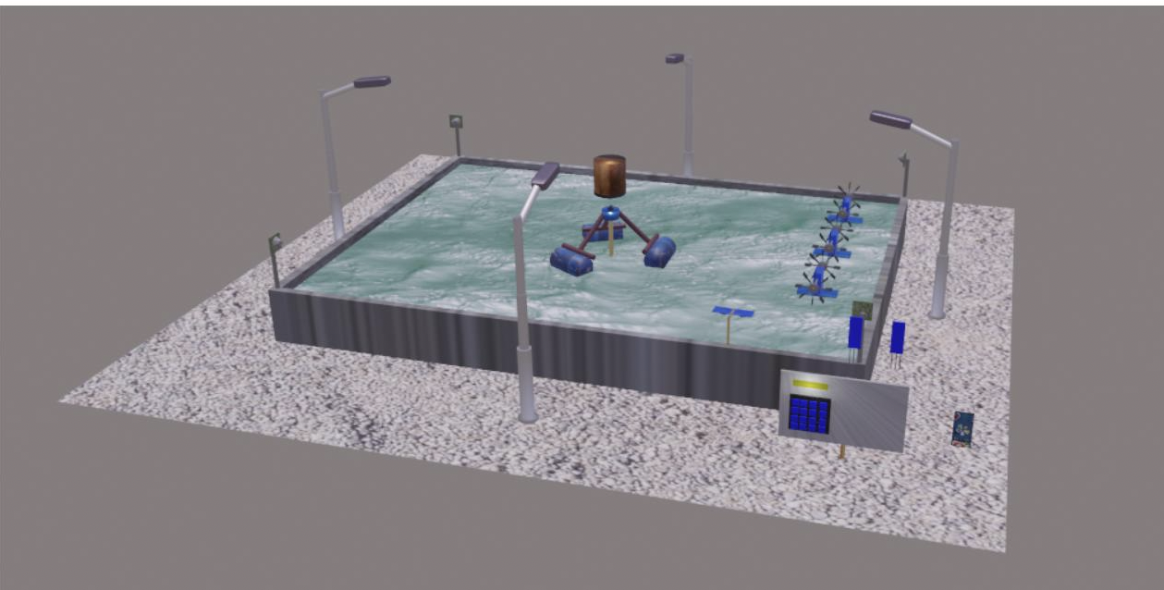
3D Diagram

Slide 8
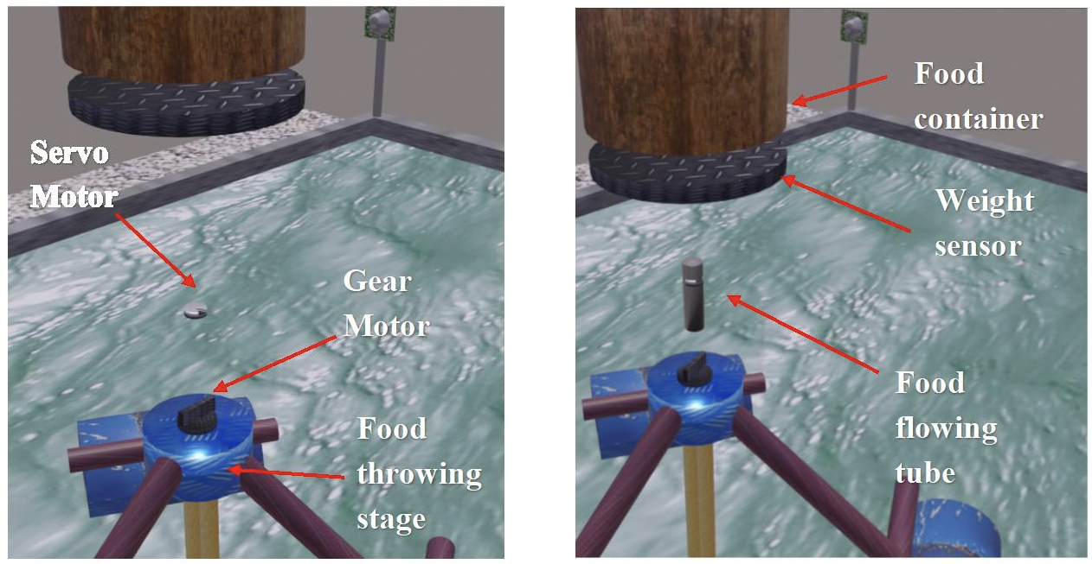
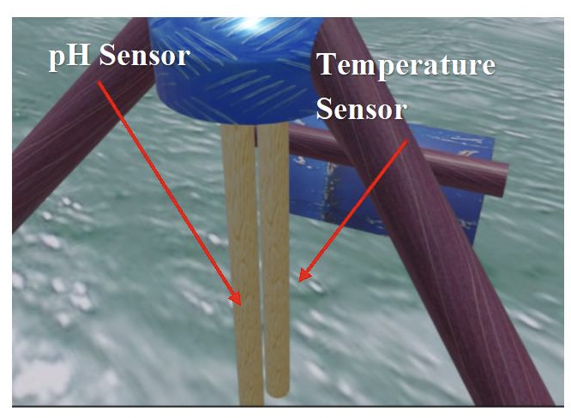

Slide 9
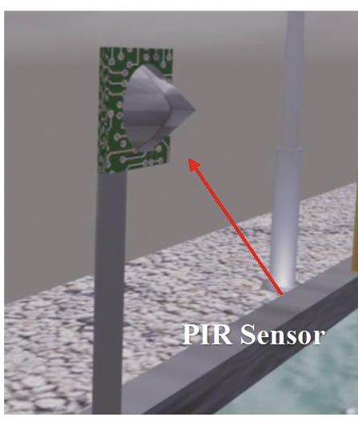
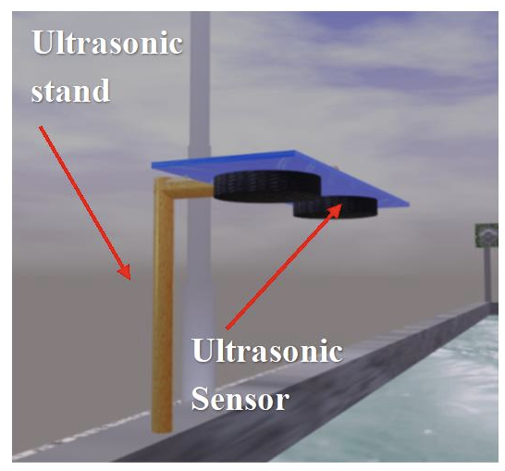
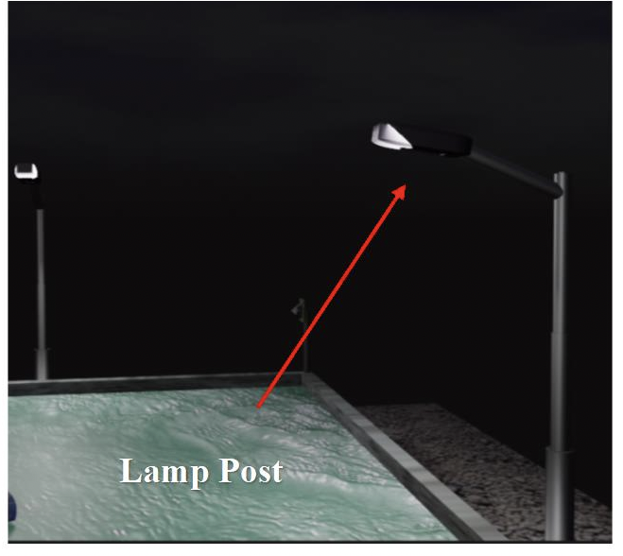
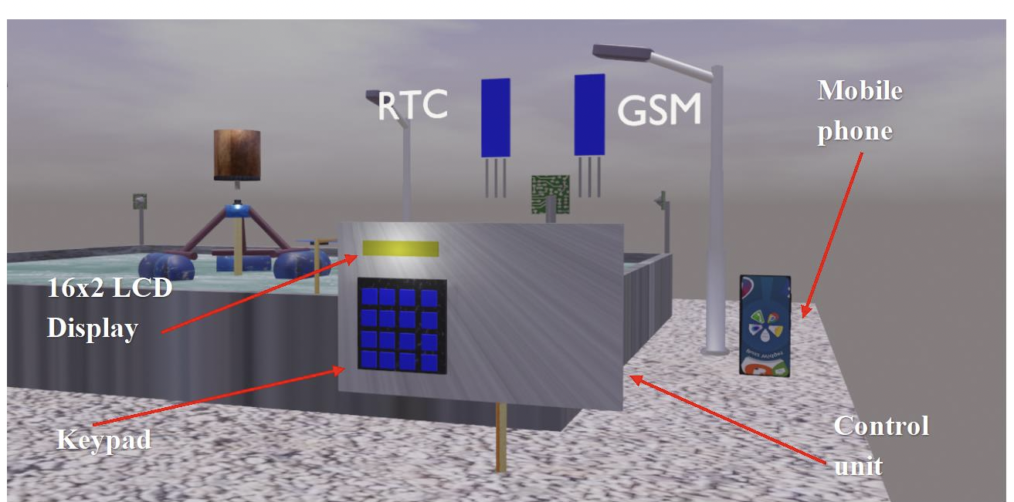
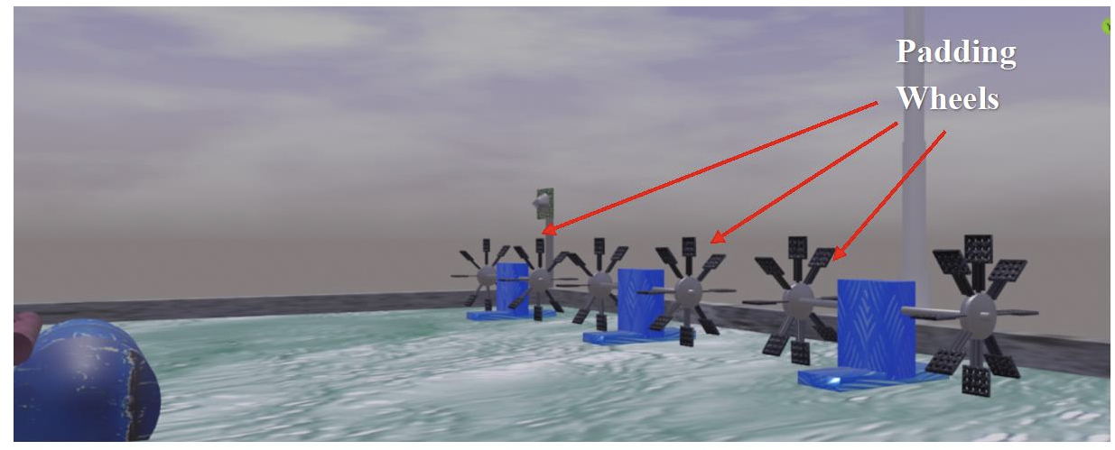

Slide 10
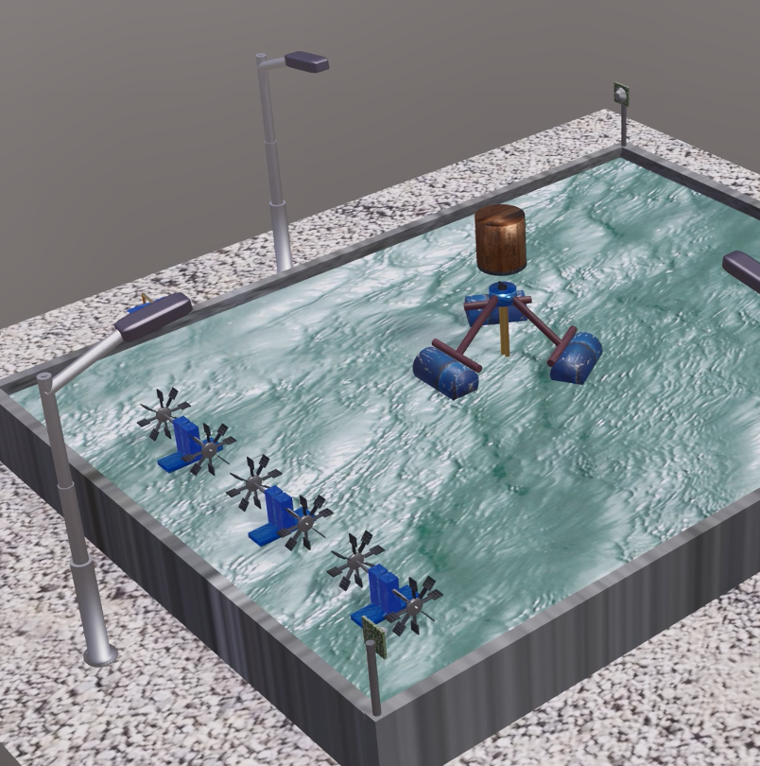
Animation
Src: Final Animation

Slide 11
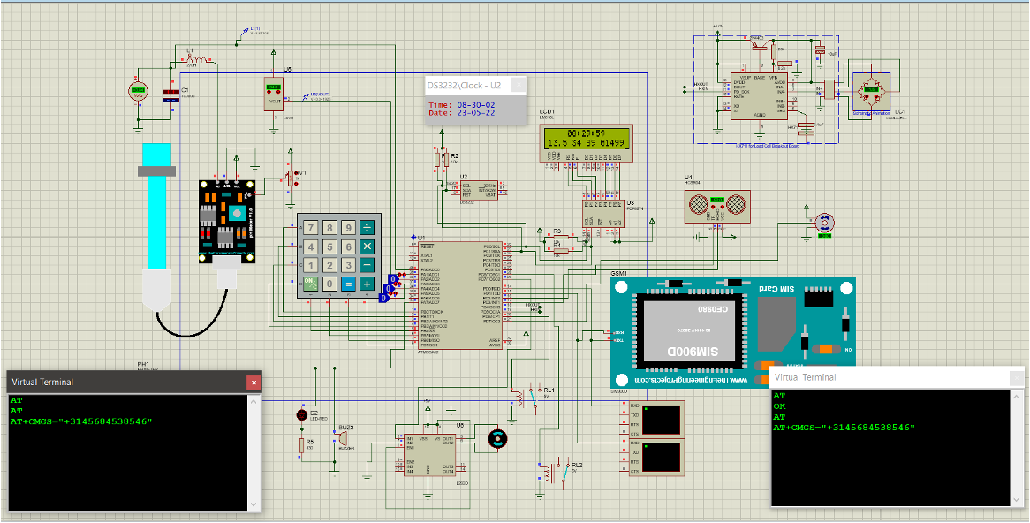
Full Circuit Diagram

Slide 12
Schematic Diagram

Slide 13
PCB Design

Slide 14
Resources Required
Hardware:
1. Sensors
● pH sensor
● Temperature sensor
● Weight sensor
● Ultrasonic sensor
● PIR Sensor
2. Relay
3. Atmega32 Controller
4. Real Time Clock Module
5. EEPROM
6. Buzzer
7. Gear Motor
8. Servo Motor
9. Keypad
10. LCD Display
11. Power Supply
12. GSM Module
Software:
Atmel Studio
Proteus
Blender
Kicad

Slide 15
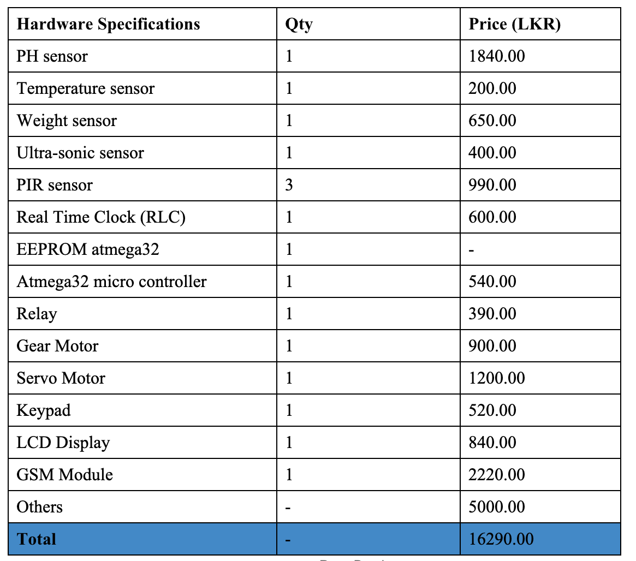
Cost Estimation

Slide 16
Testing & Implementation
First, we used proteus to simulate each of our components independently. Then we put everything together into one proteus project. After integrating the system, we encountered various problems with the proteus modeling of the GPS, Ph sensor, and GSM modules. We believe the proteus program has some flaws. When users connect too many components and simulate them, the program will be slow and crash. However, our code is appropriate, and we have securely attached our element to Atmega32.

Slide 17
Individual Contribution

Slide 18
204192X-Sara A.N.Z(Group leader)
Responsibilities
•Learning about ultrasonic sensor , servo motor, PIR sensor and how they work.
•Learning to connect Ultrasonic sensor to atmega32 microcontroller and
Refer the code part of it.
•Learning to connect Servo motor to atmega32 microcontroller
Refer the code part of it.
•Learning to connect PIR sensor to atmega32 microcontroller
Refer the code part of it.
•Identifying devices needed, when connecting these components to atmega32 microcontroller.
•Learning to do 3D animations.

Slide 19
Techniques
● Ultrasonic Sensor
The ultrasonic sensor is used here to detect the water level, when the water level goes down, and goes up, the alert messages are sent to the farmer’s phone.
● Servo Motor
Servo motor is used to control the flow of food gradually, from the main tank to the Gear motor.
● PIR Sensor
PIR sensor is used for a security purpose to protect the shrimps from the birds.

Slide 20
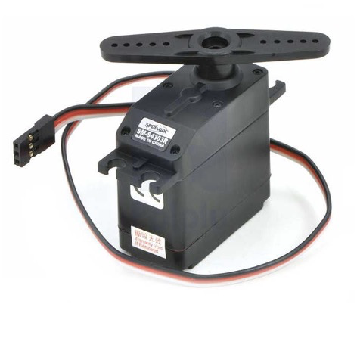
Servo Motor
Maximum Voltage = 6V
Maximum Current = 100mA
Pin = 03
●VCC
●Ground
●Signal
Link for Data sheet : https://www.tme.eu/Document/004105658202ef89808bba102ca4bf3f/POLOLU-1248.pdf

Slide 21
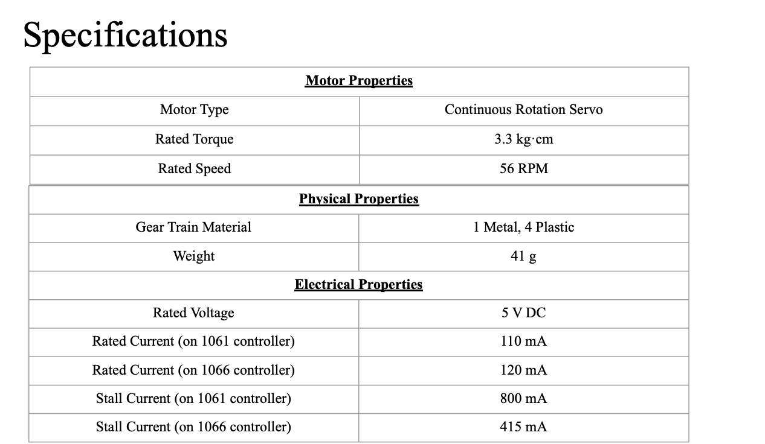

Slide 22
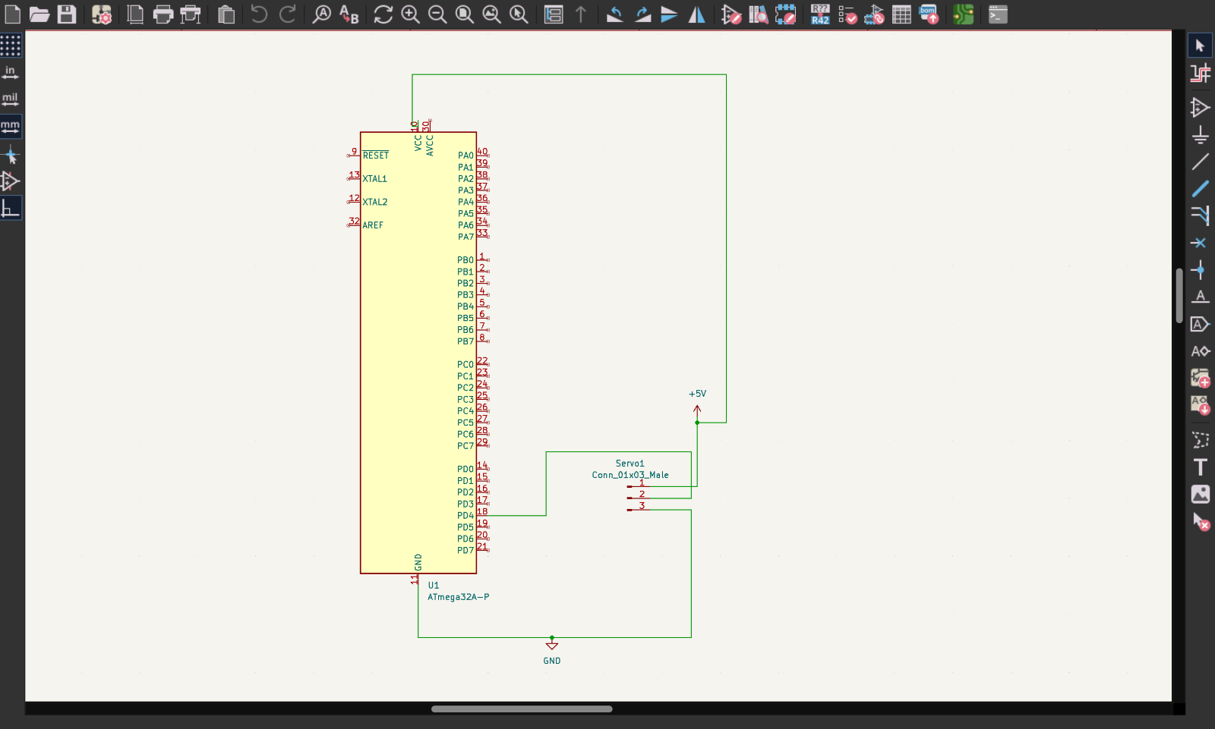
Schematic Diagram

Slide 23
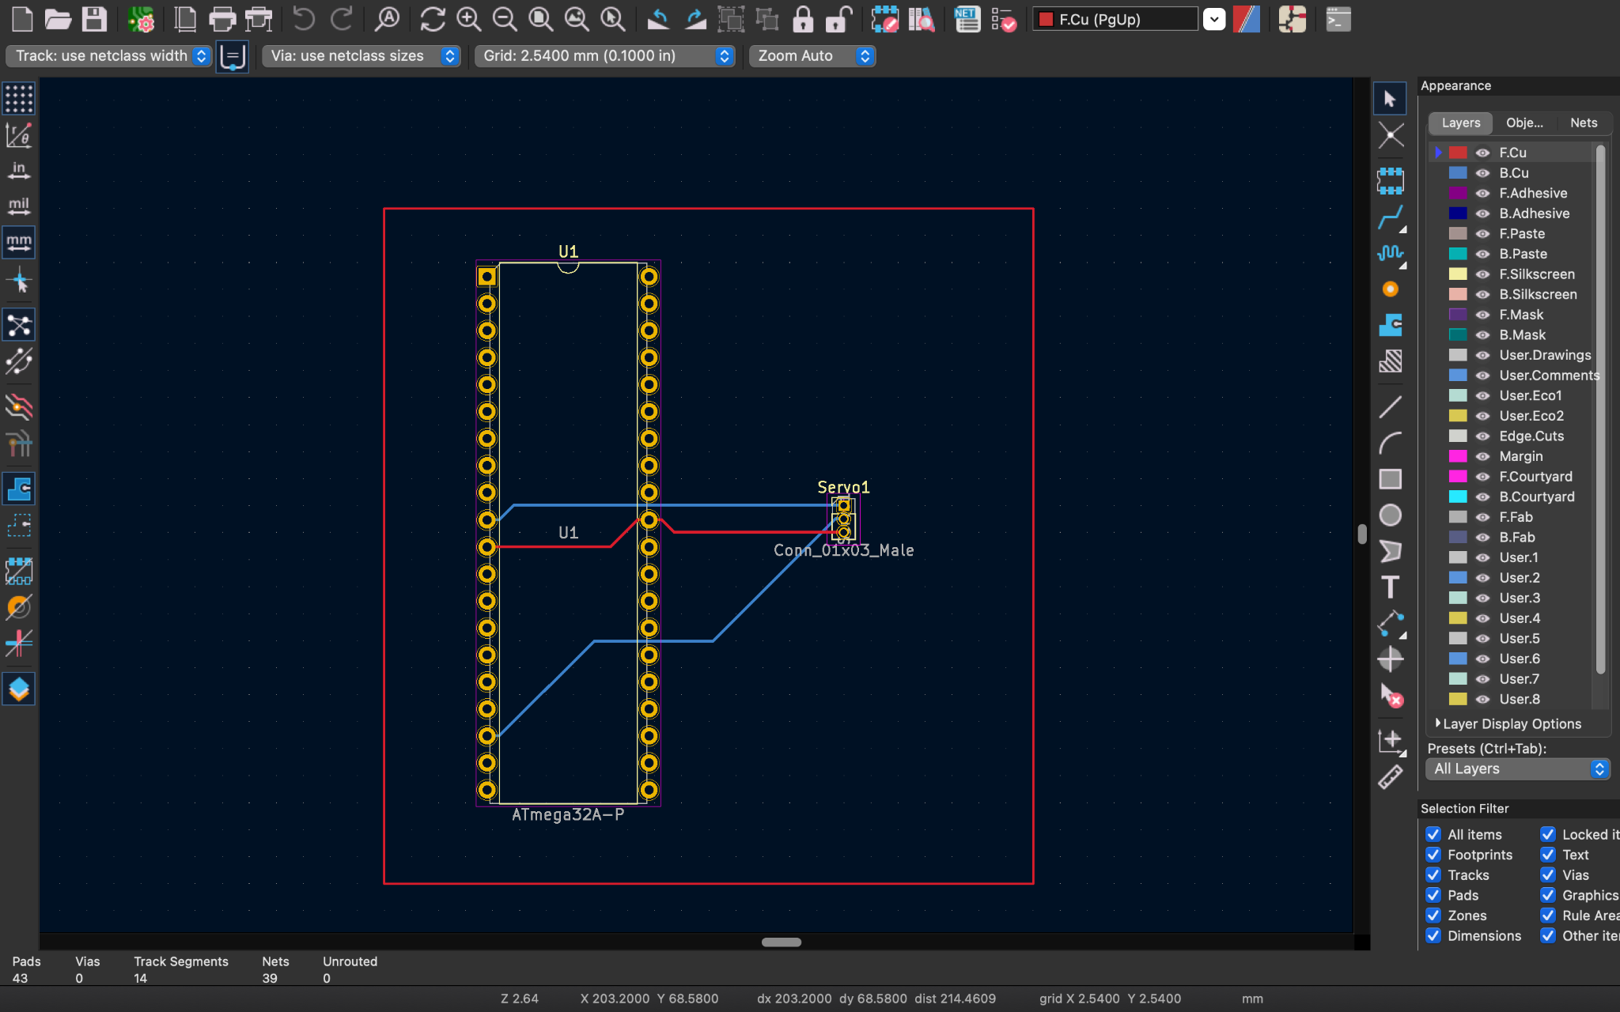
PCB Design

Slide 24
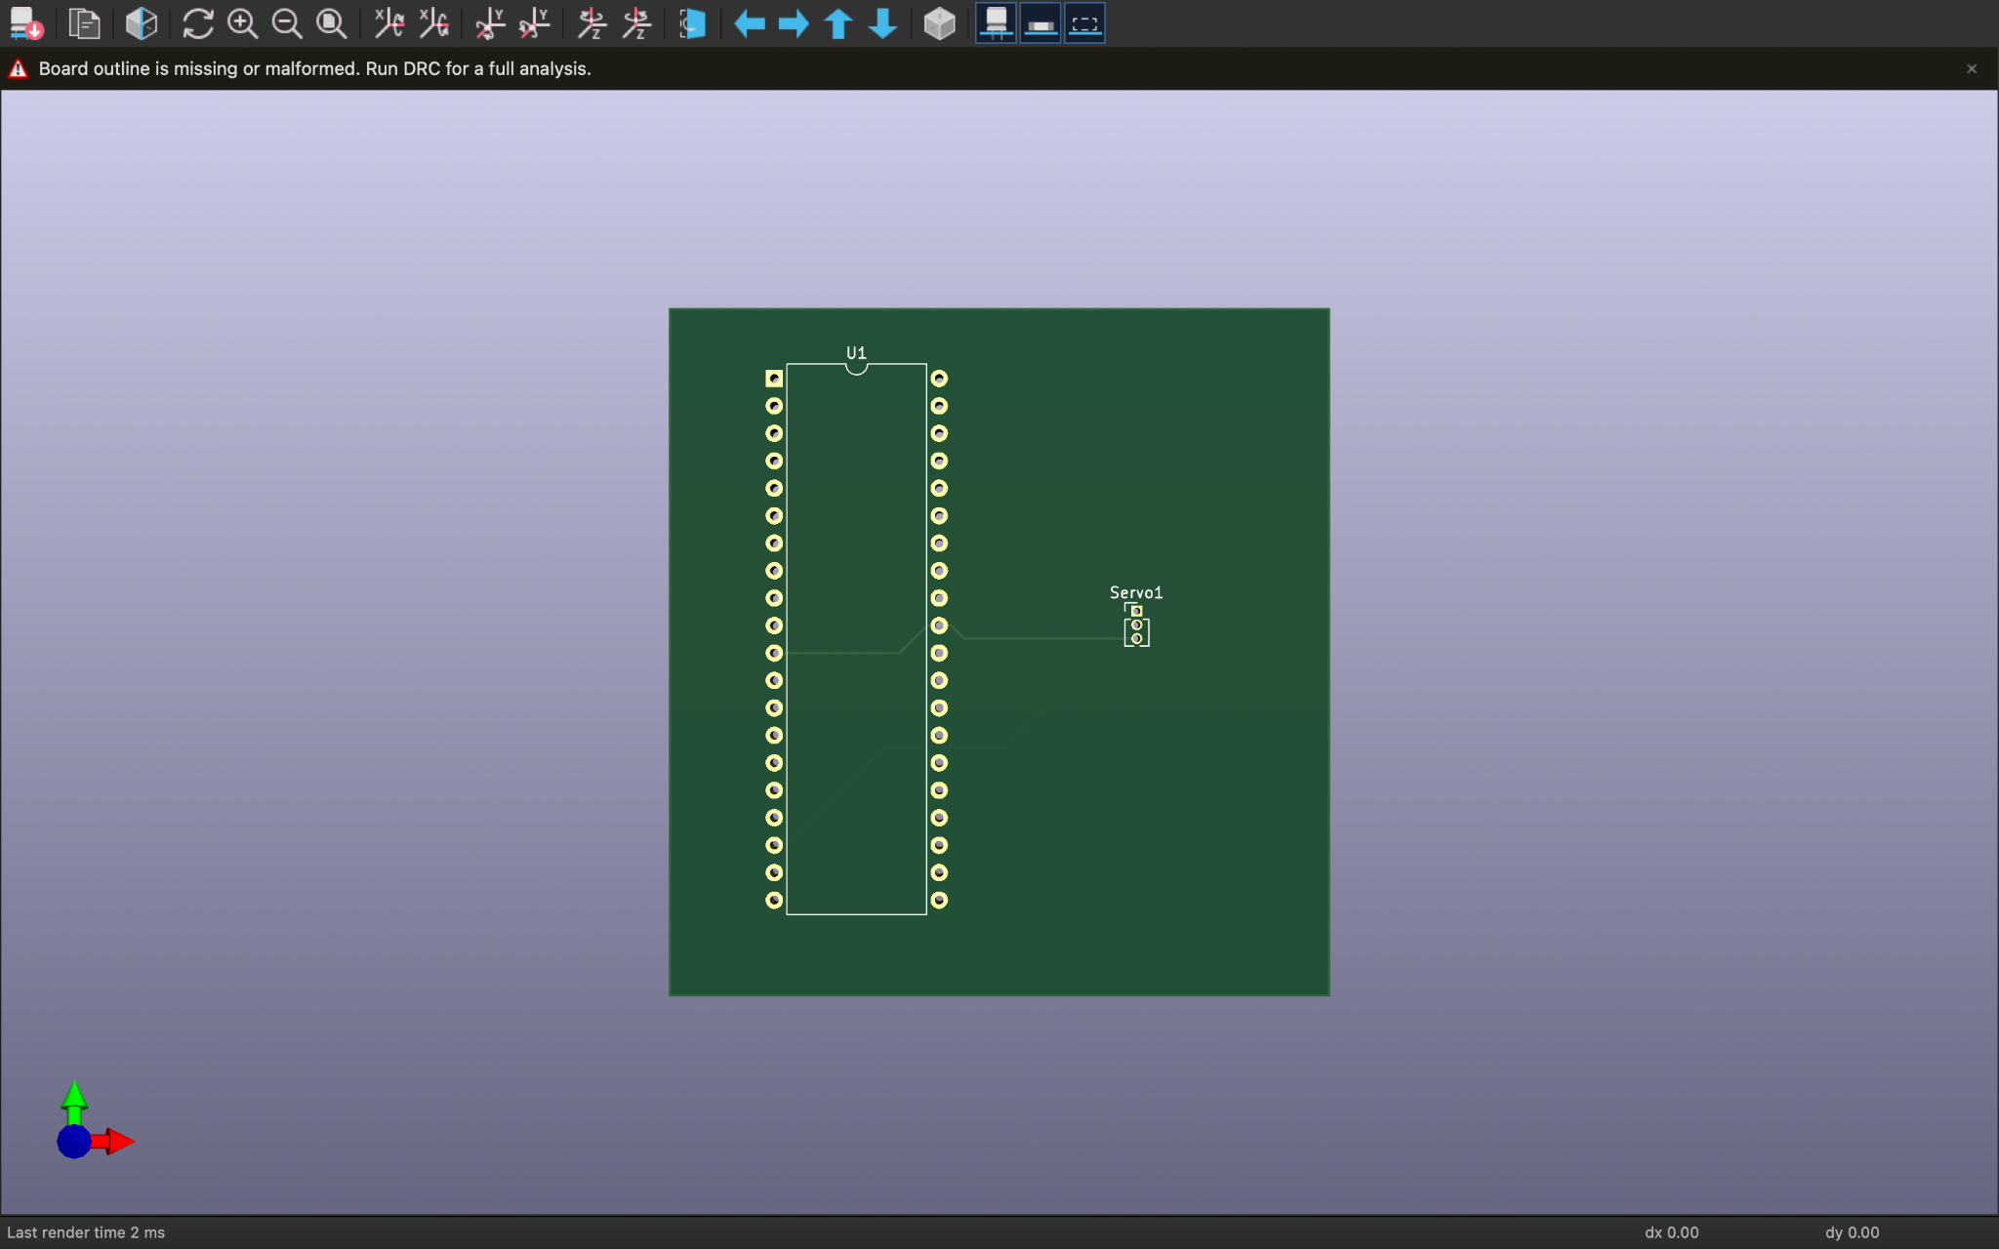
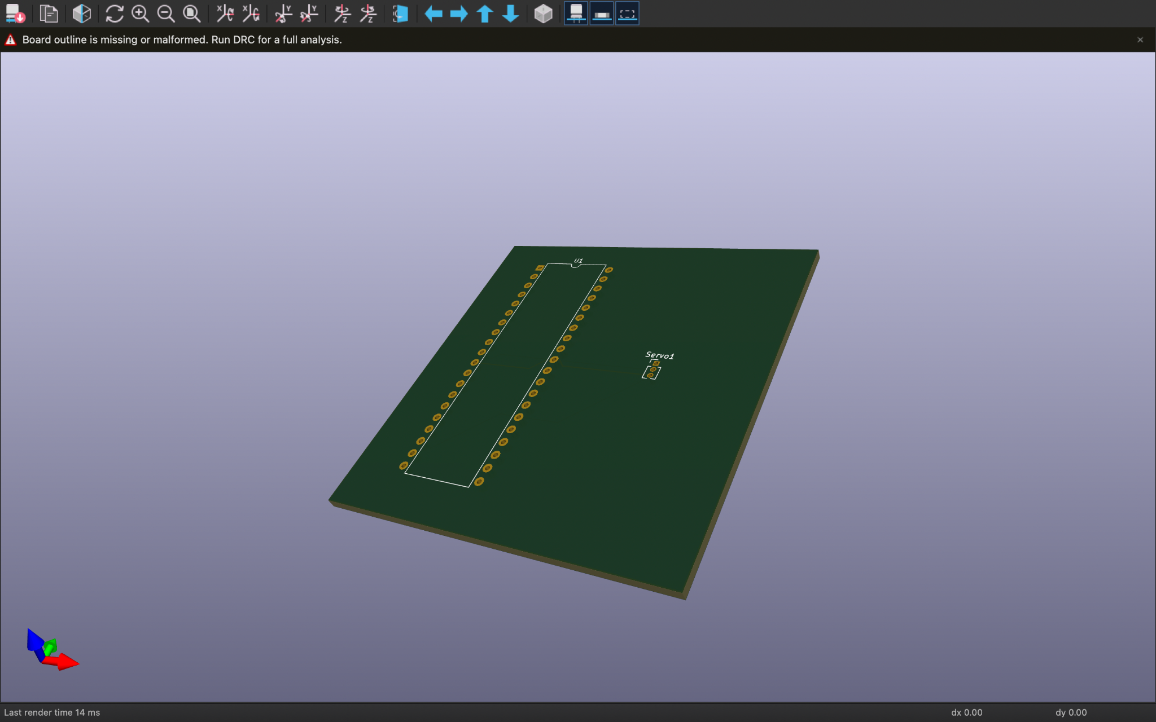
Simulation - Link:
https://github.com/Akalanka-00/Shrimp-Farming-System/blob/main/Contribution/Sara/Indivitual_Contribution_Simulation/New%20Project.pdsprj

Slide 25
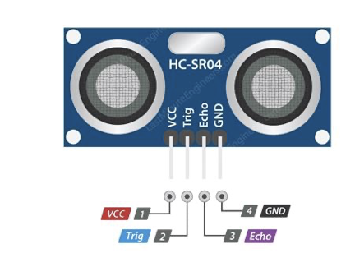
Ultra-Sonic Sensor
●Range = 2cm – 400cm
●Wire Connecting directs,
5V Supply
Trigger Pulse Input
Echo Pulse Output
0V Ground
Link for Data sheet:
https://cdn.sparkfun.com/datasheets/Sensors/Proximity/HCSR04.pdf

Slide 26
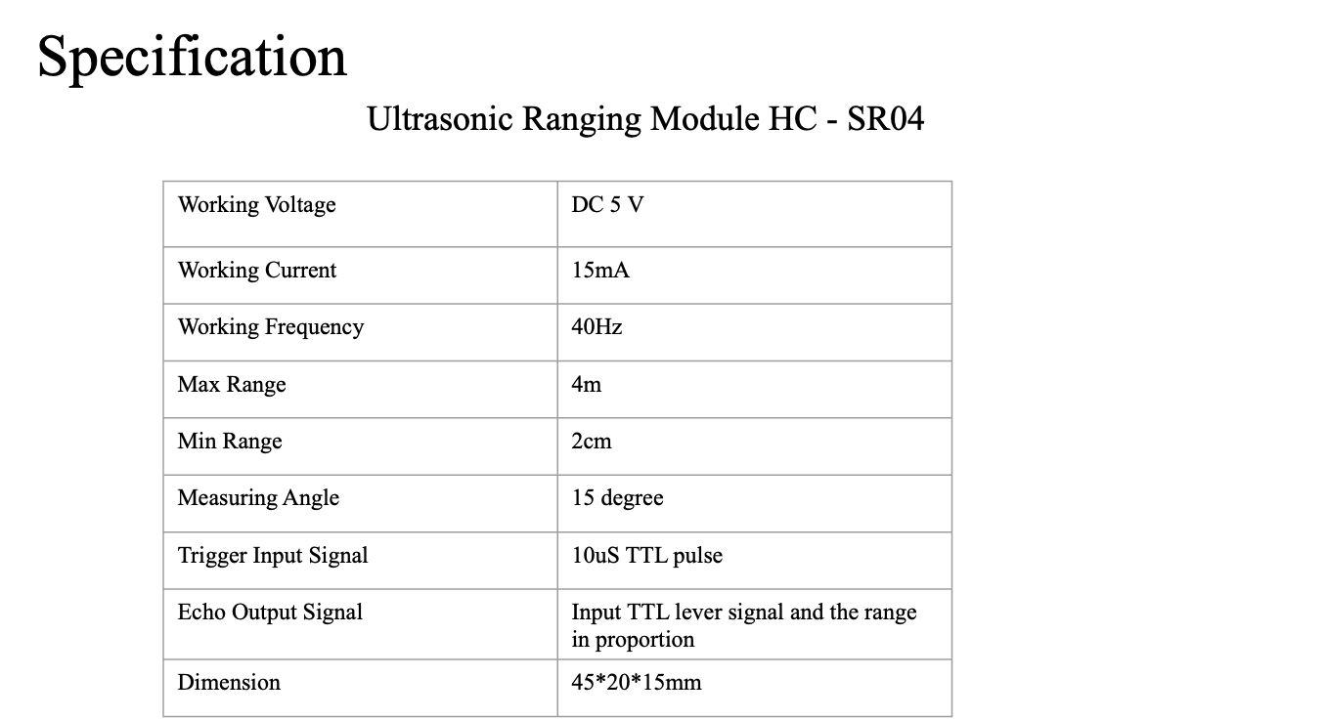

Slide 27
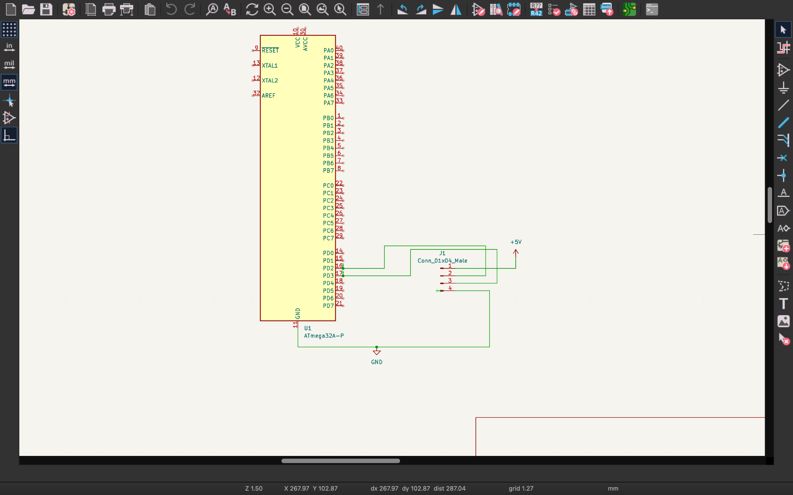
Schematic Diagram

Slide 28
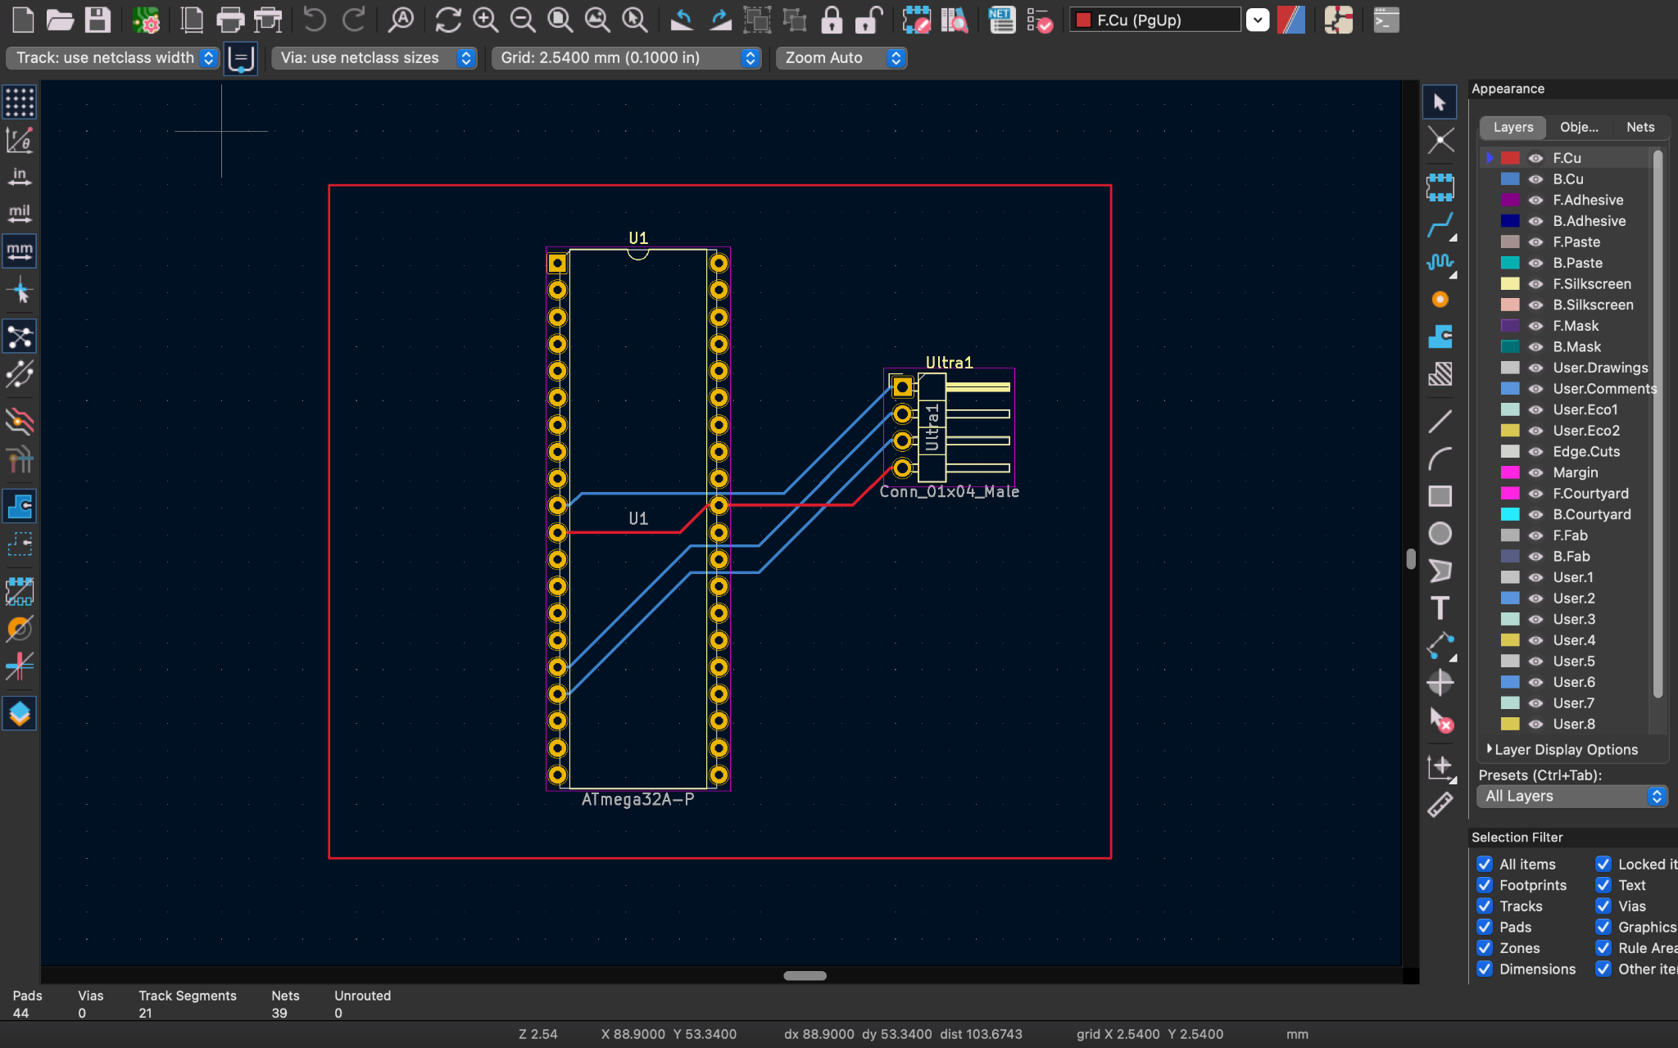
PCB Design

Slide 29
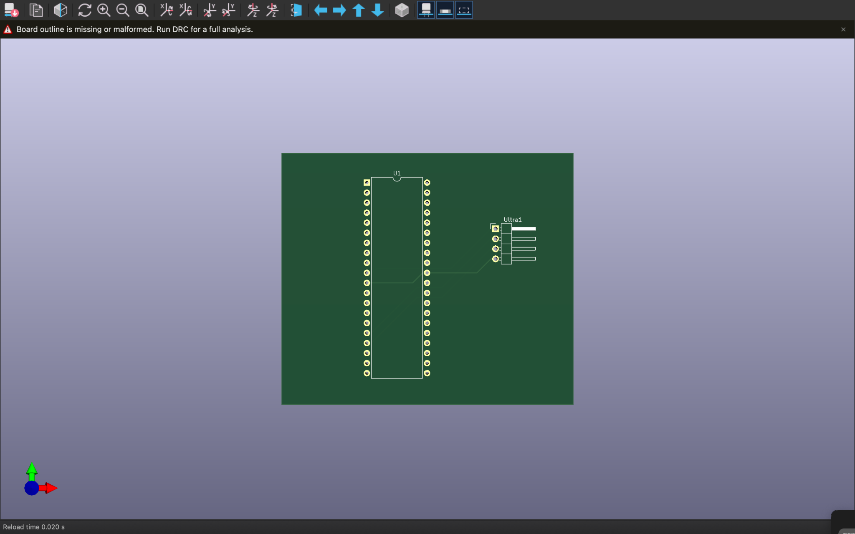
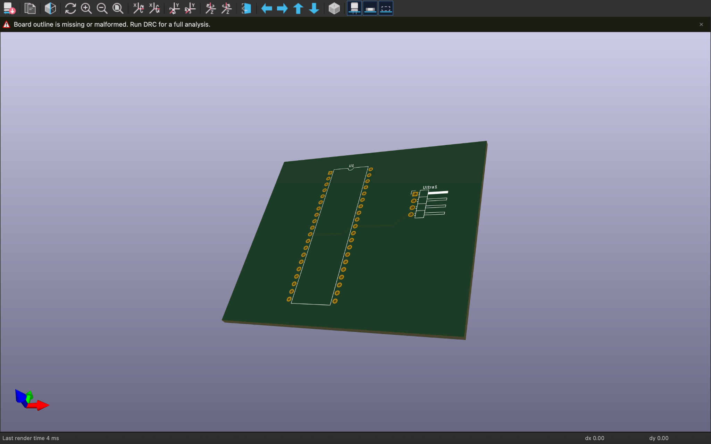

Slide 30
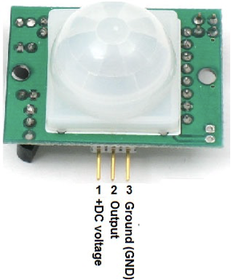
PIR Sensor
●Automatic infrared detection - Infrared technology (LHI778 probe design)
●High sensitivity | high reliability
●Ultra-low-voltage
●Widely used especially for battery-powered products
Link for Data sheet
https://datasheetspdf.com/pdf-file/775435/ETC/HC-SR501/1

Slide 31
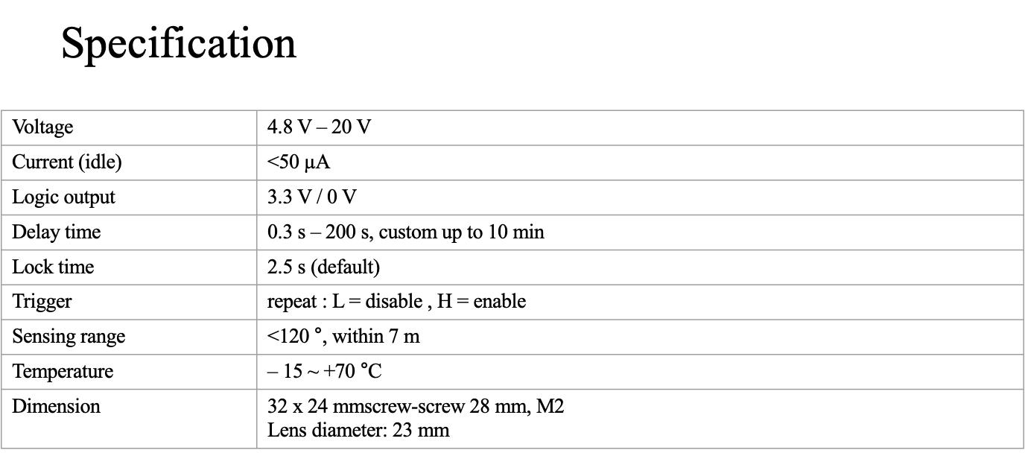

Slide 32
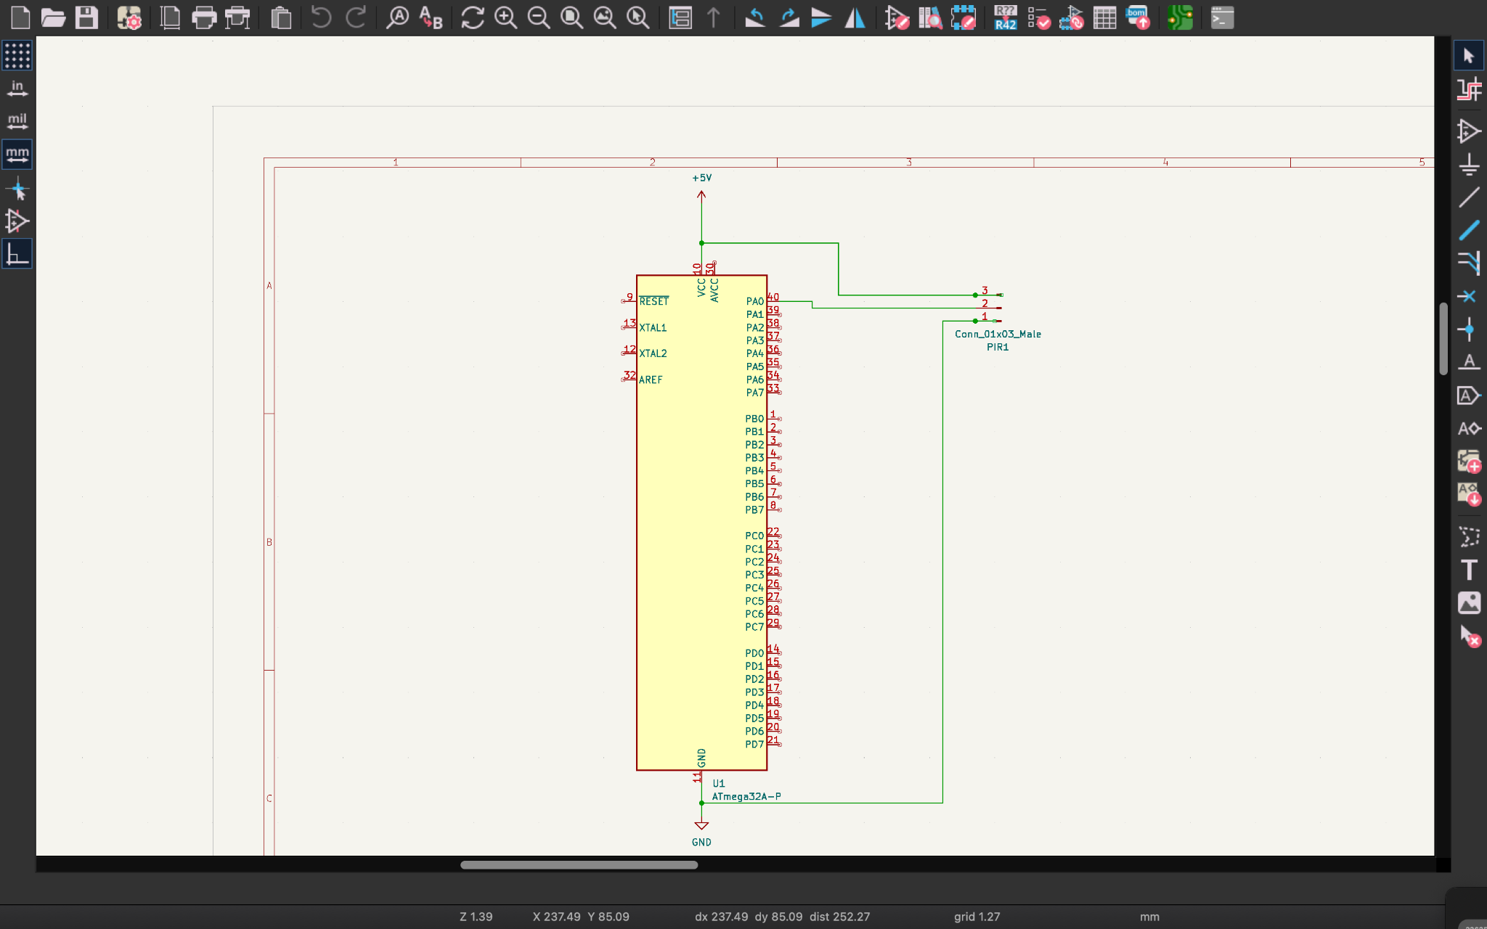
Schematic Diagram

Slide 33
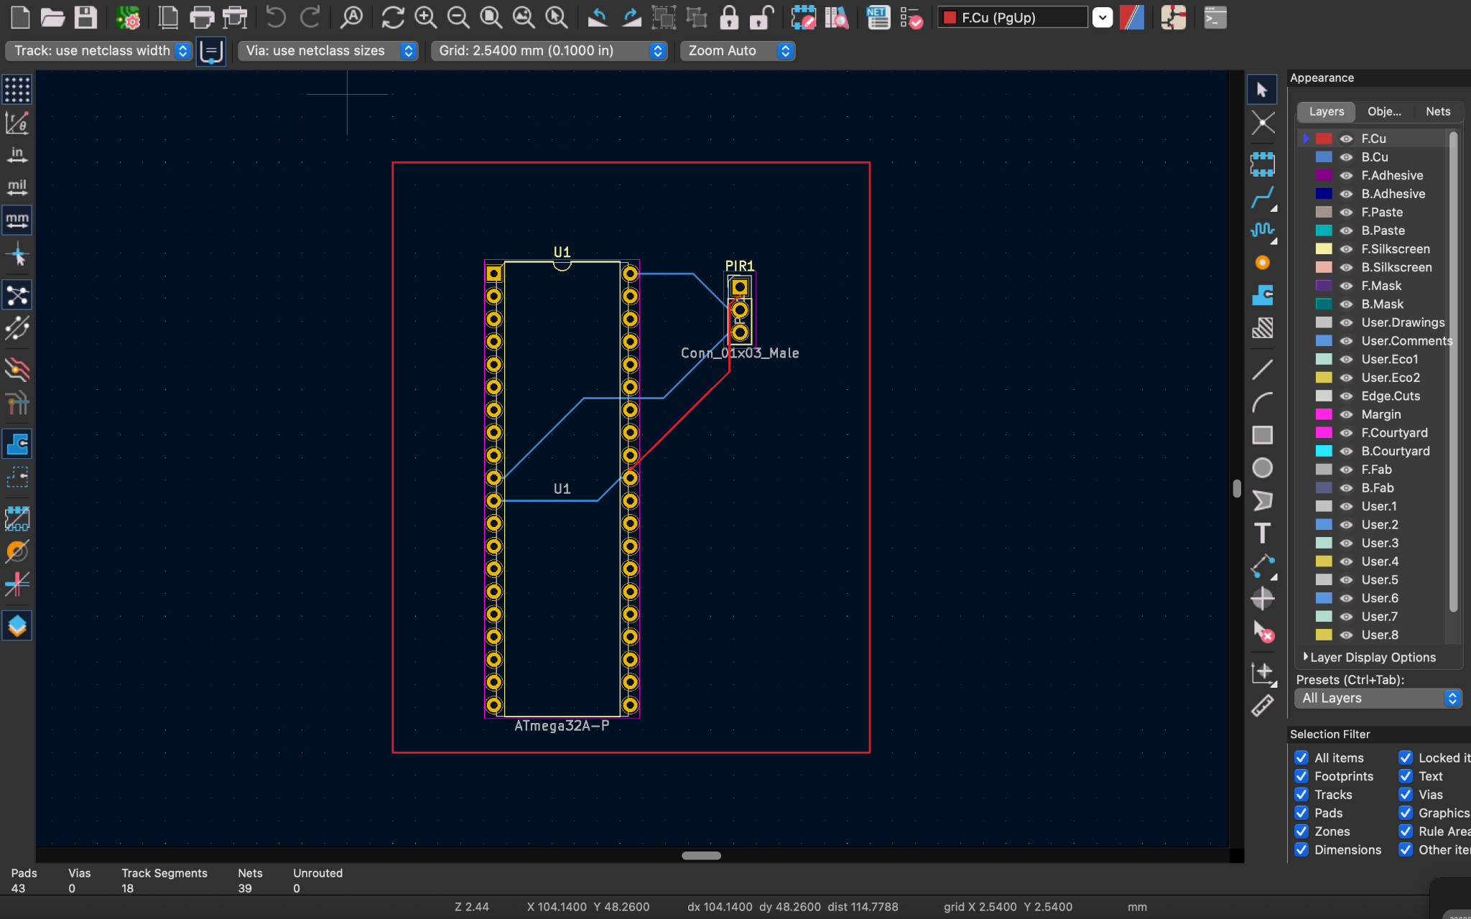
PCB Design

Slide 34
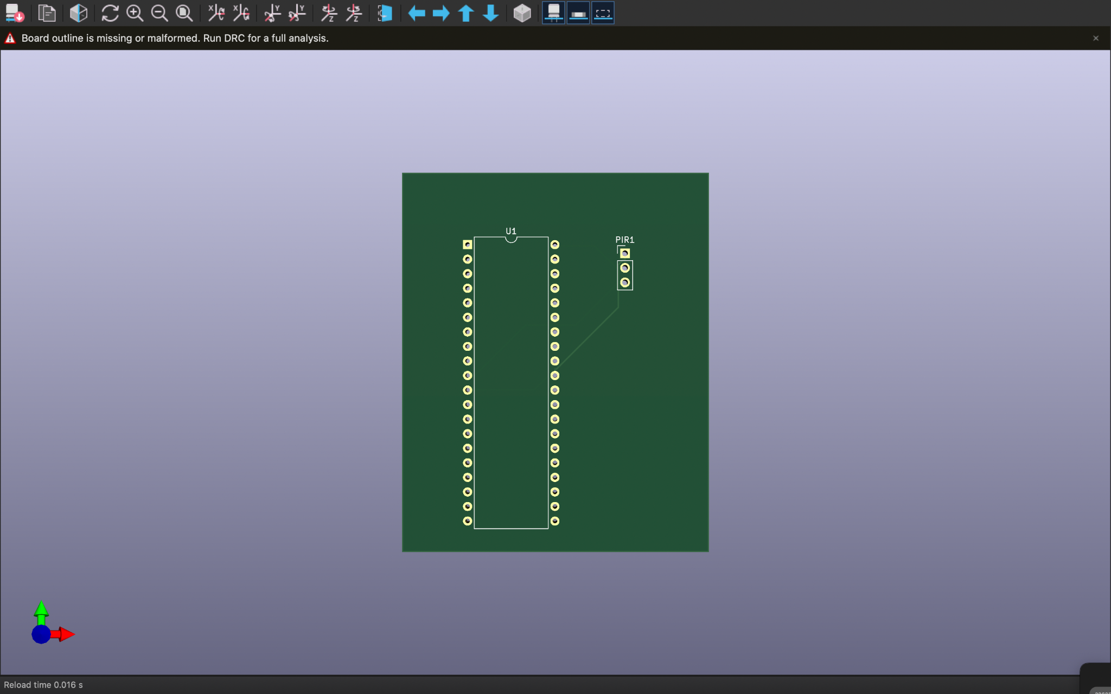
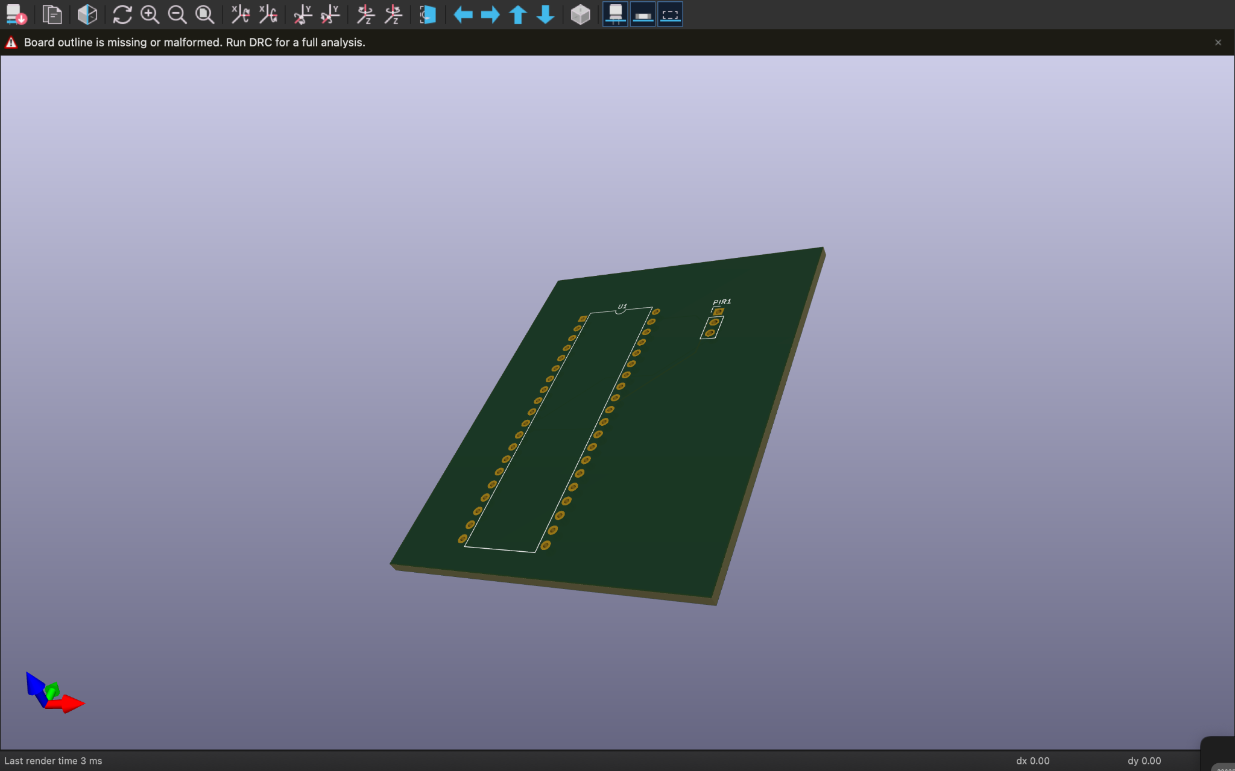

Slide 35
Member 02: Megasuriya M.M.A.M.J- 204130H
Responsibilities
•Learning pH sensor ,relay, keypad and how it works
•Identifying the correct pins and components models
•Learning How to connect to pH sensor to atmega32 microcontroller
Refer the code part of them
•Learning How to connect to relay to atmega32 microcontroller
Refer the code part of them
•Learning How to connect to keypad to atmega32 microcontroller
Refer the code part of them
•Do the simulations of pH sensor, relay and keypad
•Identifying devices needed to when connecting to those sensors to atmega32 microcontroller
•Learning to do 3D animations

Slide 36
Techniques
●PH sensor
PH sensor is used for masuring the ph value in the pond. ph value between 5 and 9 is best for the survival of the shrimp.When the pH is less than 5 or higher than 9, a message is sent over the
phone to inform the prawn that it is detrimental to its survival.

